Slide 1
Android Authenticity Prediction
Capstone Project - 3
By Prathik Mane

Slide 2
Problem Statement
This dataset consists of apps needed permissions during installation and run-time. We collect apps from three different sources: google play, third-party apps and malware dataset. This file contains more than 30,000 Android apps. Features extracted at the time of installation and execution. One file contains the name of the features and others contain a .apk file corresponding to extracted permissions with respective packages. Apps are collected from Google's play store, hiapk, app china, Android, mumayi, gfan slideme, and pandaapp. These .apk files collected from the last three years continuously contain 81 distinct malware families. But, here we are only supposed to predict whether the app is benign(0) or malware(1).
The objective of this project is to predict whether the android app is malware or benign based on Category, Rating, Number of ratings, Price, Dangerous permissions count, Safe permissions count and other such factors

Slide 3
Data Description
This dataset contains 29,999 rows and 184 columns.
1. App :- Name of the App
2. Package :- OBB/Data package installed in root folder
3. Category:- App Category (eg. Entertainment, Adventure, puzzle, Action, Antivirus, etc.)
4. Description :- App Description
5. Rating: Rating out of 5
6. Number of ratings:- No. of Ratings given by users
7. Price :- Price of the App
8. Related apps :- Apps related to installed App
9. Dangerous (D) permissions count :- No. of Dangerous Permissions allowed by user
10. Safe (S) permissions count :- No. of Safe Permissions allowed by user
11. Default : Access DRM content. (S) :- 0 : No, 1: Yes
12. Default : Access Email provider data (S) :- 0 : No, 1: Yes
13. Default : Access all system downloads (S) :-0: No, 1: Yes
14. Default : Access download manager. (S) :- 0 : No, 1: Yes
15. Default : Advanced download manager functions. (S) :- 0 : No, 1: Yes
16. Default : Audio File Access (S) :- 0 : No, 1: Yes
17. Default : Install DRM content. (S) :- 0 : No, 1: Yes
18. Default : Modify Google service configuration (S) :- 0 : No, 1: Yes
19. Default : Modify Google settings (S) :- 0 : No, 1: Yes
20. Default : Move application resources (S) :- 0 : No, 1: Yes
21. Default: Read Google settings (S) :- 0 : No, 1: Yes
22. Default : Send download notifications. (S) :-0: No, 1: Yes
23. Default : Voice Search Shortcuts (S)-0: No, 1: Yes
24. Default : access SurfaceFlinger (S) :- 0 : No, 1: Yes
25. Default: access checkin properties (S) :- 0 : No. 1: Yes
26. Default: access the cache filesystem (S) :- 0 : No, 1: Yes
27. Default : access to passwords for Google accounts (S)-0: No, 1: Yes
:
:
:
:
:
:
184. Class : 0: Benign, 1: Malware

Slide 4
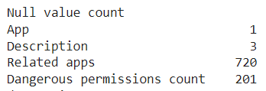
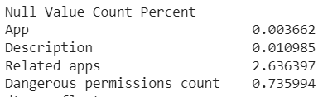
Data Cleaning and Manipulation
Given dataset has 2689 duplicates, which were dropped using drop_duplicates()
Dataset has missing values in it . App has 1 missing values, Description has 3 missing values, Related Apps has 720 missing values, Dangerous Permissions count has 201 missing values.
As the mentioned columns has less than 3% of the values missing in it. Therefore, we can drop these rows

Slide 5
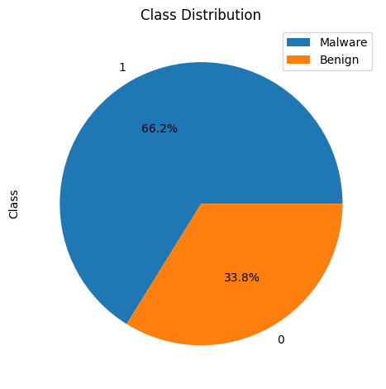
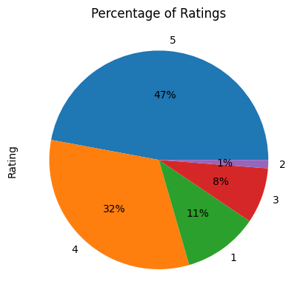
EDA
1. As Malware class constitute of 66.2% of dataset, we can say that the dataset is imbalanced
2. Percentage of ratings is calculated by binning the numerical ratings into 1,2,3,4,5 categories.
3. If rating is between 4 & 5 then it is binned into category 5 and so on
4. Almost half of the ratings are between 4 & 5, followed by 31% of ratings between 3 & 4.
Very few(1%) of people rated the apps between 0 & 1

Slide 6
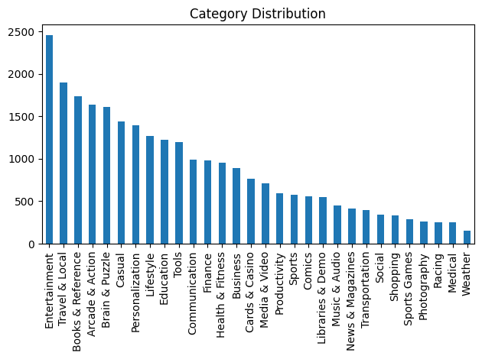
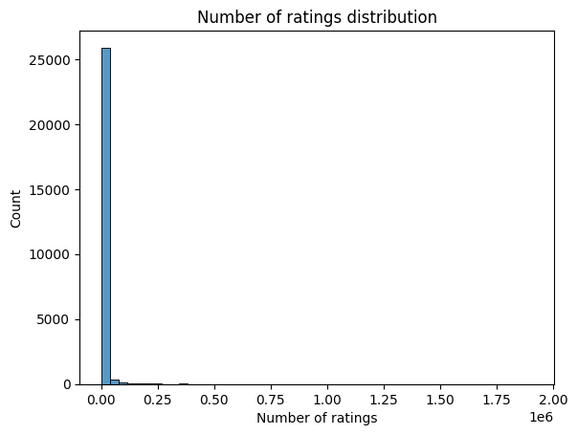
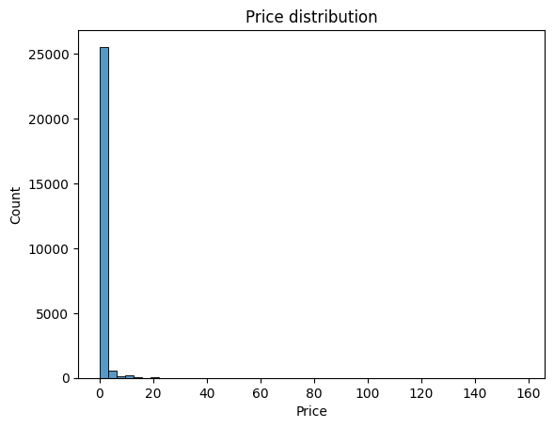
Majority of android apps are from “Entertainment” Category, followed by “Travel & Local”, “Books & Reference”
And thereafter the number of apps the respective categories is gradually declining
Most of the apps have no ratings i.e., zero number of ratings
Very few apps have been given ratings
Majority of android apps have zero price i.e.; they are free to use
Very few apps are required to be paid to use them

Slide 7
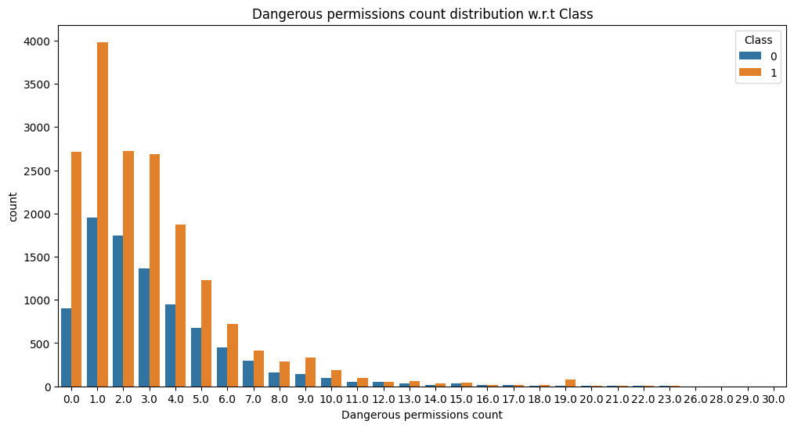
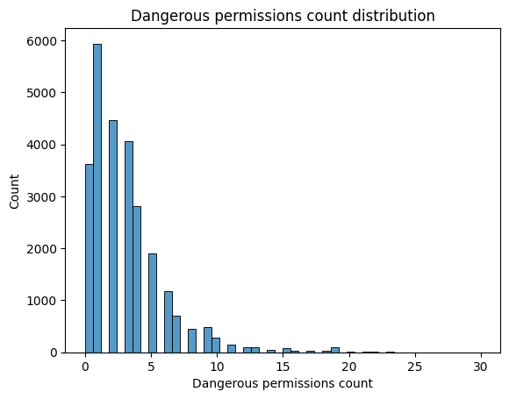
Majority of the apps have less than 5 dangerous permission count.
Very few apps require more than 20 dangerous permissions.
Also, Benign and Malware apps both have similar distribution of Dangerous Permissions count.

Slide 8
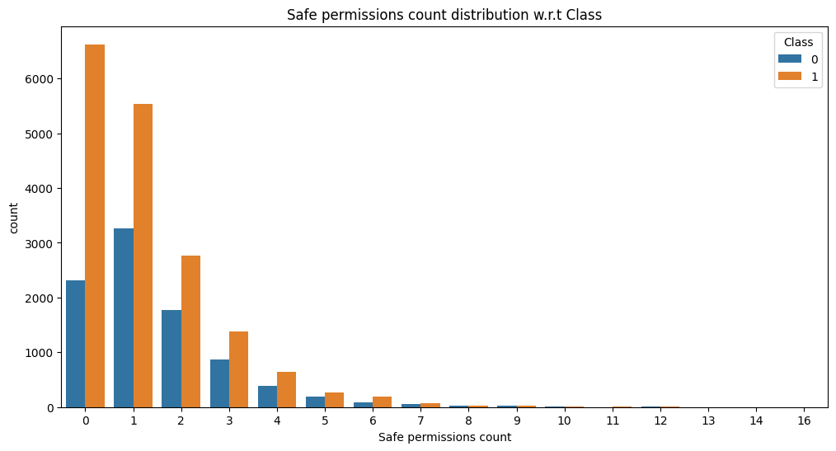
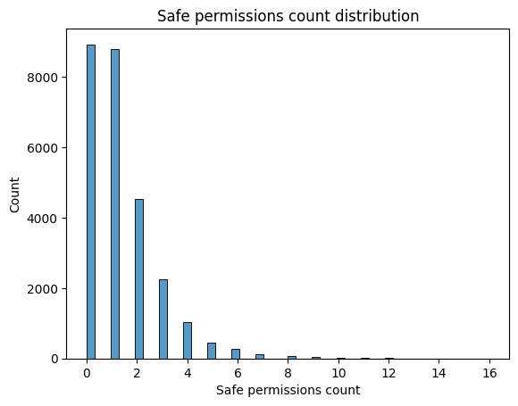
Majority of the apps have less than 2 safe permission count
Very few apps require more than 8 safe permissions
There are more safe app permissions given to Malware apps than Benign apps
Also, Benign and Malware apps both have similar distribution of safe Permissions count

Slide 9
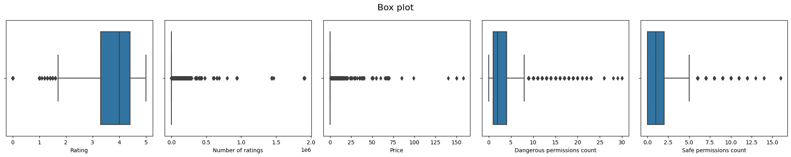
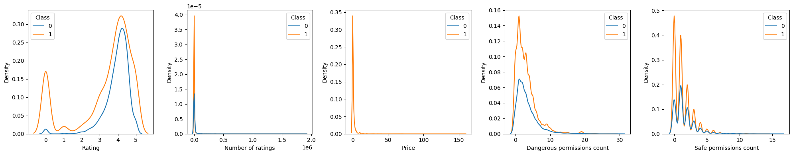
Distribution of data
'Rating', 'Number of ratings', 'Price', 'Dangerous permissions count' & 'Safe permissions count' have outliers in them.
'Number of ratings', 'Price', 'Dangerous permissions count' & 'Safe permissions count’ is positively skewed

Slide 10
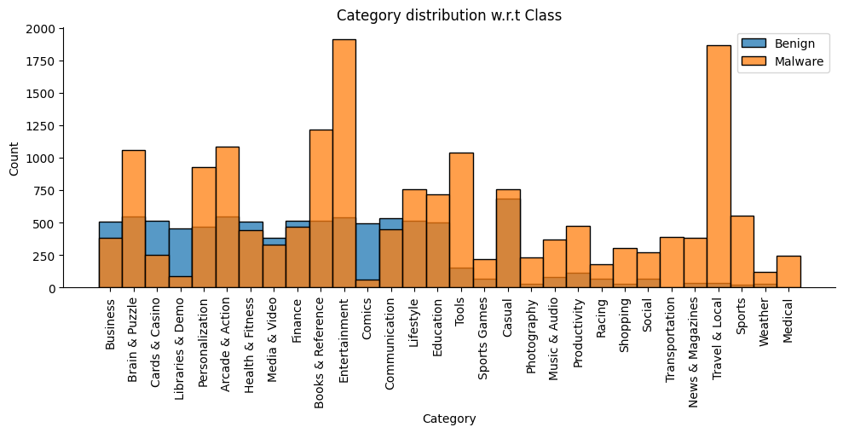
Most of the categories have more malware apps then benign apps
Business, ‘Cards& Casino’, ‘Libraries & Demo’, ‘Heath& Fitness’, ‘Media & Video’, ‘Comics’, ‘Communication’, ‘Casual’ Categories have more benign apps than malware apps

Slide 11
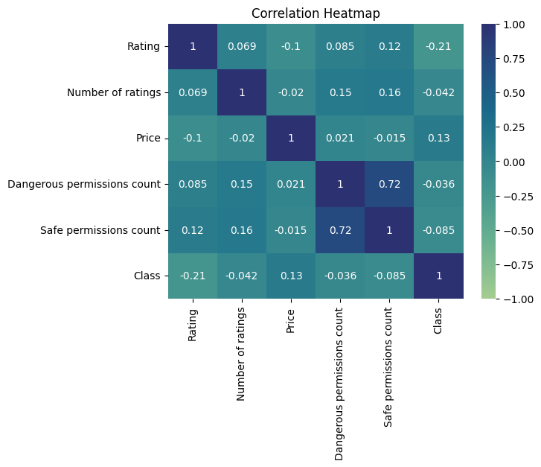
Correlation Heatmap
‘Dangerous Permissions count’ and ‘Safe Permissions count’ are highly correlated(0.72), means more the number of Dangerous Permissions Count, it is more likely that it will have more safe Permissions count as well
‘Rating’ and ‘Class’ are negatively correlated, means if the Ratings decrease, then the app is more likely to be Malware
‘Rating’ and ‘Price’ is also negatively correlated, means more the Ratings of the app, less price or the app is likely to be free of cost to use

Slide 12
List of algorithms used
DecisionTree Classifier
Logistic Regression
SVM Classifier
RandomForest Classifier

Slide 13
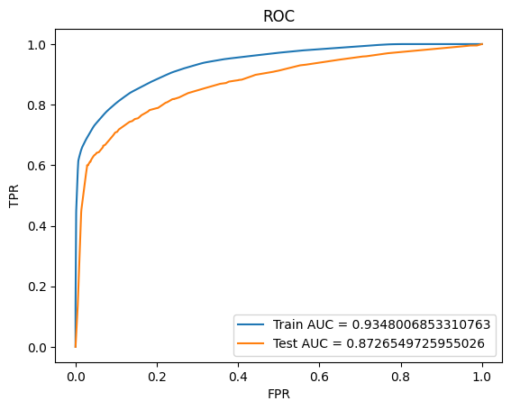
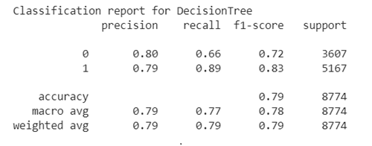
DecisionTree Classifier
The model achieved an overall accuracy of 0.79, indicating that it correctly predicted the target variable for approximately 79% of the instances.
The precision for class 0 (0's) is 0.80, indicating that out of all the instances predicted as 0's, 80% were actually 0's. The recall for class 0 is 0.66, meaning that the model correctly identified 66% of the actual 0's.
The precision for class 1 (1's) is 0.79, indicating that out of all the instances predicted as 1's, 79% were actually 1's. The recall for class 1 is 0.89, meaning that the model correctly identified 89% of the actual 1's.
The F1-score is a measure of the model's accuracy, considering both precision and recall. For class 0, the F1-score is 0.72, and for class 1, it is 0.83

Slide 14
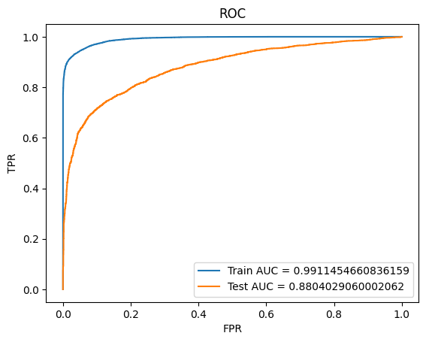
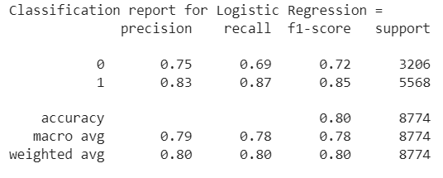
Logistic Regression
The model achieved an overall accuracy of 0.80, indicating that it correctly predicted the target variable for approximately 80% of the instances.
The precision for class 0 (0's) is 0.75, indicating that out of all the instances predicted as 0's, 75% were actually 0's. The recall for class 0 is 0.69, meaning that the model correctly identified 69% of the actual 0's.
The precision for class 1 (1's) is 0.83, indicating that out of all the instances predicted as 1's, 83% were actually 1's. The recall for class 1 is 0.87, meaning that the model correctly identified 87% of the actual 1's.
The F1-score is a measure of the model's accuracy, considering both precision and recall. For class 0, the F1-score is 0.72, and for class 1, it is 0.85.

Slide 15
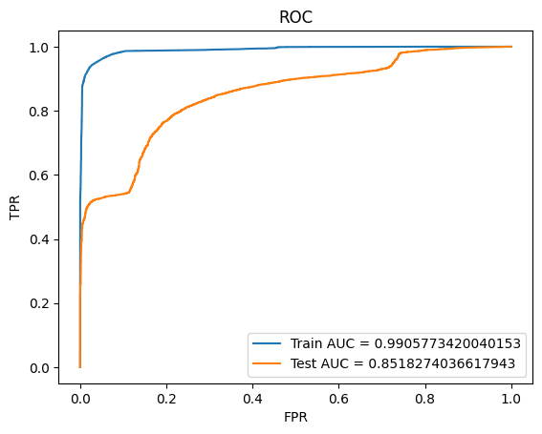
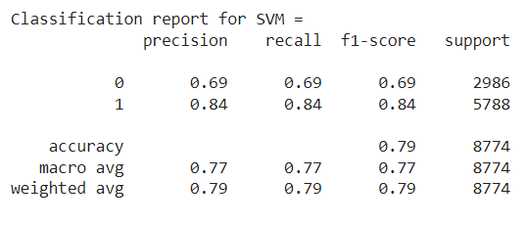
SVM classifier
The model achieved an overall accuracy of 0.79, indicating that it correctly predicted the target variable for approximately 79% of the instances.
The precision for class 0 (0's) is 0.69, indicating that out of all the instances predicted as 0's, 69% were actually 0's. The recall for class 0 is also 0.69, meaning that the model correctly identified 69% of the actual 0's.
The precision for class 1 (1's) is 0.84, indicating that out of all the instances predicted as 1's, 84% were actually 1's. The recall for class 1 is also 0.84, meaning that the model correctly identified 84% of the actual 1's.
The F1-score is a measure of the model's accuracy, considering both precision and recall. For class 0, the F1-score is 0.69, and for class 1, it is 0.84

Slide 16
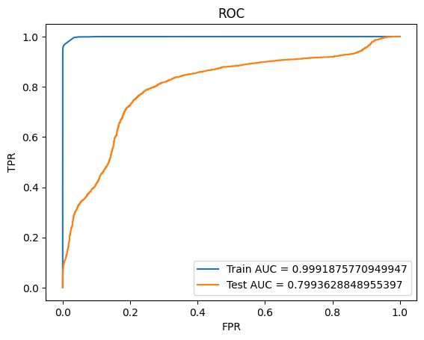
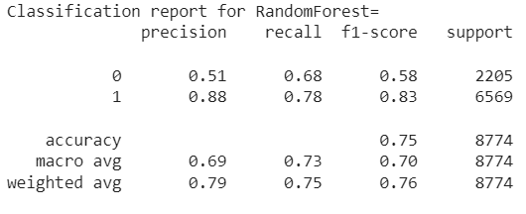
RandomForest Classifier
The model achieved an overall accuracy of 0.75, indicating that it correctly predicted the target variable for approximately 75% of the instances.
The precision for class 0 (0's) is 0.51, indicating that out of all the instances predicted as 0's, 51% were actually 0's. The recall for class 0 is 0.68, meaning that the model correctly identified 68% of the actual 0's.
The precision for class 1 (1's) is 0.88, indicating that out of all the instances predicted as 1's, 88% were actually 1's. The recall for class 1 is 0.78, meaning that the model correctly identified 78% of the actual 1's.
The F1-score is a measure of the model's accuracy, considering both precision and recall. For class 0, the F1-score is 0.58, and for class 1, it is 0.83.

Slide 17
Future Scope
TFIDF Vectorization with n-gram parameter: The models can be further improved by incorporating TFIDF vectorization with the n-gram parameter set. This technique can help capture the contextual information and improve the model's performance by considering word combinations.
Hyperparameter Tuning: More extensive hyperparameter tuning can be conducted to optimize the models further. For example, in Logistic Regression, different solvers like 'newton-cg', 'lbfgs', and 'liblinear' can be explored. Similarly, for SVM, different kernels such as 'poly', 'rbf', and 'sigmoid' can be experimented with, while setting gamma='scale'. Additionally, in RandomForest, exploring different values for the 'n_estimators' parameter can be beneficial.
Cross-Validation: Instead of using a CV value of 3, increasing it to 10 or more (e.g., CV=10) can provide a more reliable evaluation of the models' performance. Cross-fold validation helps in obtaining a better estimate of how the models would perform on unseen data.
By incorporating these future steps, the models can be further refined and potentially achieve better performance in predicting the authenticity of Android apps

Slide 18
Conclusion
Exploratory Data Analysis (EDA):
The dataset is imbalanced, with a majority of the apps being classified as malware (66.2%).
Ratings are skewed towards higher values, with a significant proportion falling between 4 and 5.
The Entertainment category has the highest number of Android apps, followed by Travel & Local and Books & Reference.
Most Android apps are free, with only a small number requiring payment.
The count of dangerous permissions and safe permissions is generally low for the majority of apps, with outliers observed in some features.
Certain categories have a higher proportion of malware apps, while others have a higher proportion of benign apps.
Positive correlation exists between the count of dangerous permissions and safe permissions.
Negative correlation is observed between the 'Rating' feature and the 'Class' and 'Price' features.
Modeling and Evaluation:
Four machine learning algorithms were used: DecisionTree Classifier, Logistic Regression, SVM, and RandomForest Classifier.
Evaluation on the training set revealed that Logistic Regression had the highest test AUC score.
The DecisionTree Classifier did not exhibit overfitting, while the RandomForest Classifier showed significant overfitting.
In conclusion, although Logistic Regression achieved the highest AUC score on the test set, it was prone to overfitting. On the other hand, the DecisionTree Classifier performed well without overfitting, making it the better choice among the evaluated models. Further optimization and fine-tuning of the models could be explored to improve their performance

